Slide 1
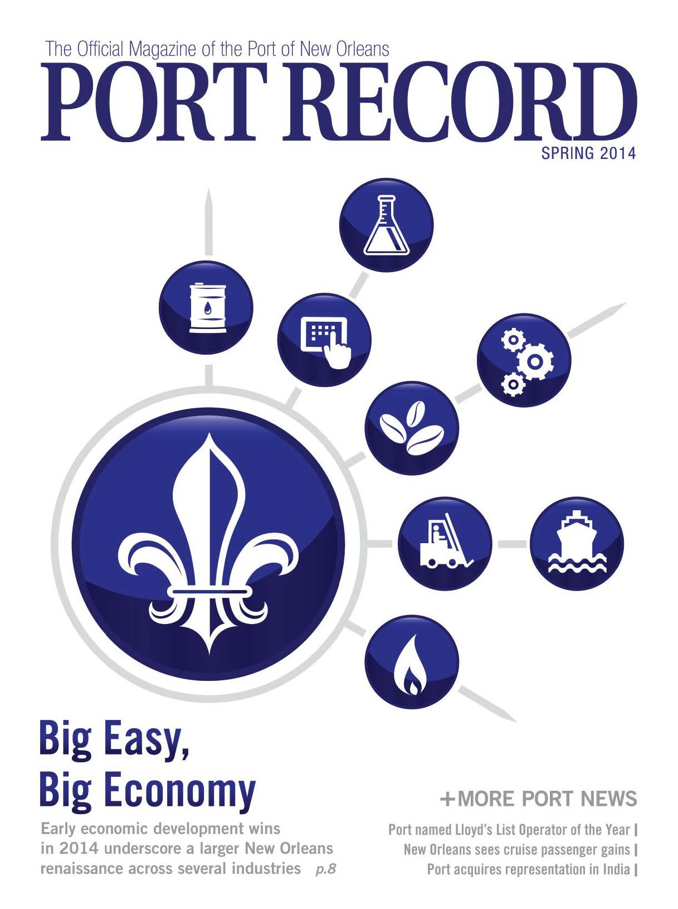
Port of
New Orleans
Port Record Magazine The Official Magazine of the
Port of New Orleans
Periodicals

